Slide 1

A n a l y s I s
on Movies
By：Yijun Wang

Slide 2

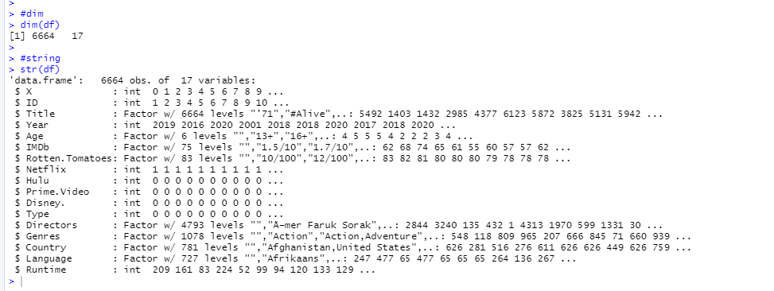
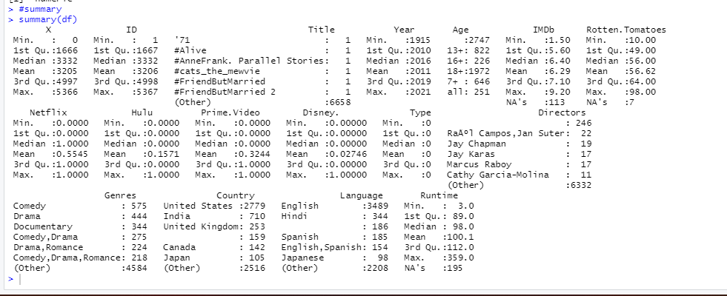
Summary
This dataset contains 6664 variables, 4 service platform
- Netflix,
- Hulu,
- Prime.Video
- Disney.
Total 6664 ID in this dataset.

Slide 3
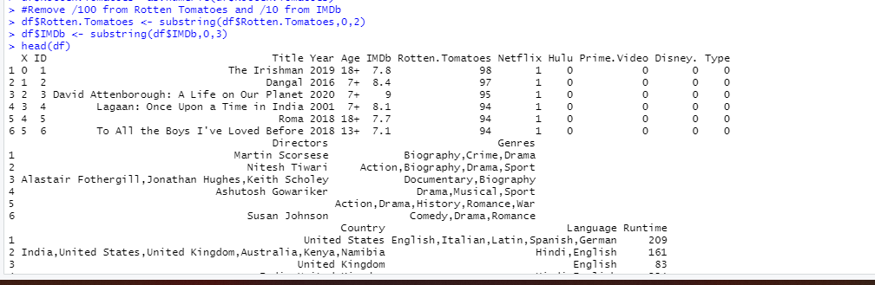
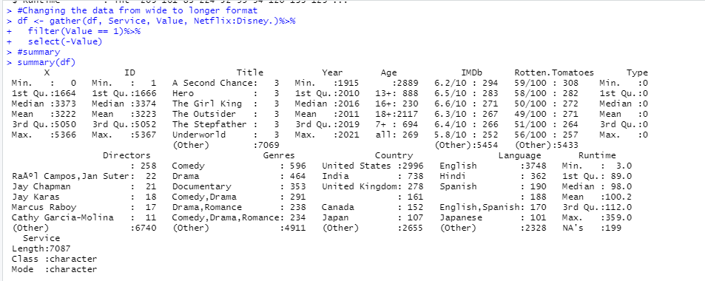
Remove “/100” from Rotten Tomatoes and “/10” from IMDb
Remove blank value from “Age”
Data Clean
Changing the data from wide to longer format

Slide 4
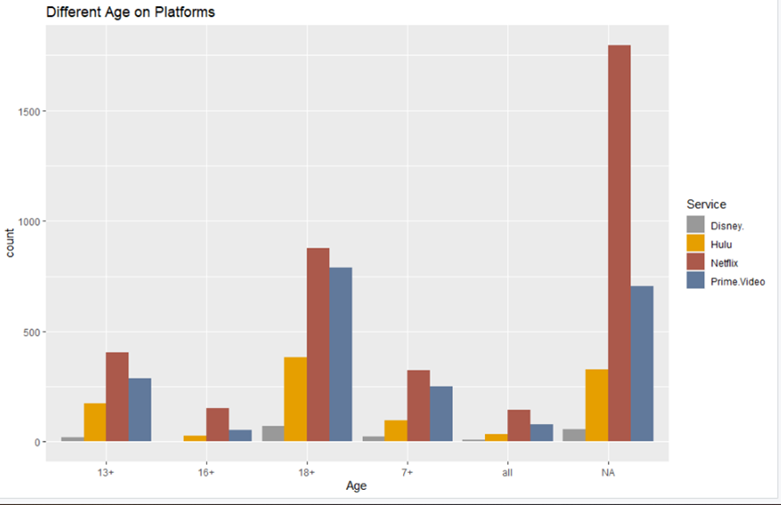

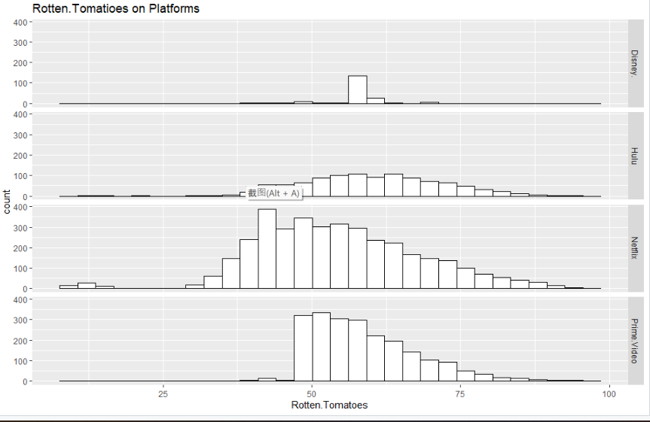
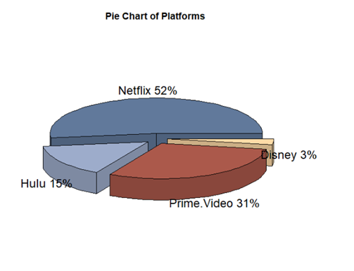
Here are the Rotten Tomatoes ratings for movies shown on different platforms
- Netflix has an average rating
- Disney's rating is low
Visualiztion
Regardless of the age group, it is Netflix that shows the most movies. Prime Video is next
Netflix occupies more than half of the number of movies, the least is Disney

Slide 5

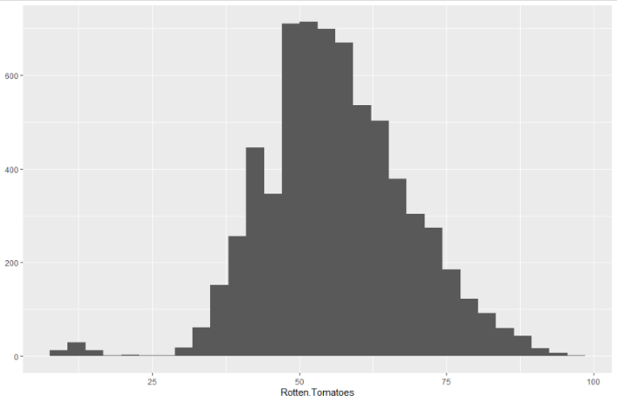
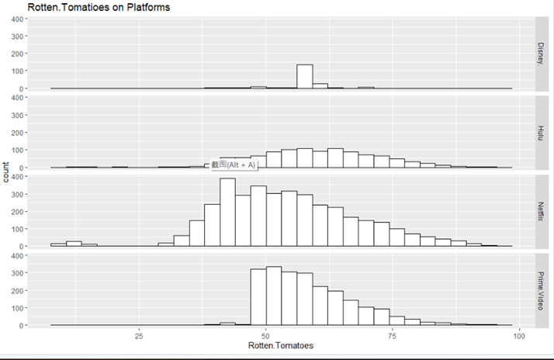
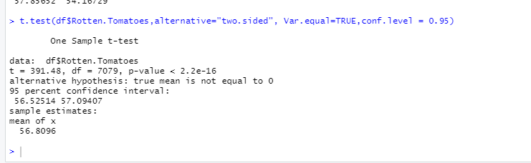
Question 1
The mean of Rotten.Tomatoes is greater equal to 55 or less than 55
Question
(Ho) Null Hypothesis: The mean of Rotten.Tomatoes >= 55
(Ha) Alternate Hypothesis: The mean of Rotten.Tomatoes < 55
The average score of Rotten Tomatoes is less than 55
Bar chart of Rotten. Tomatoes
Each platform of Rotten. Tomatoes
95% Confidence interval for difference: (56.52514,57.09407)
Difference: 7079
T-value = 391.48, P-value <2.2e-16 (<0.05)

Slide 6
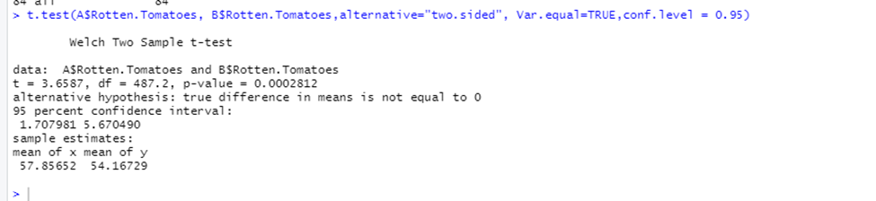
Question 2
"16+"&"all “has any difference on Rotten. Tomatoes score?
(Ho) Null Hypothesis: The Difference is equal to 0.
(Ha) Alternate Hypothesis: The Difference is not equal to 0.
Difference = mu (A Sample) – mu (B Sample)
Ho: Null Hypothesis: Difference = 0
Ha: Alternate Hypothesis: Difference ≠ 0
95% Confidence interval for difference: (1.707981, 5.670490)
Difference: 487.2
T-value = 3.6587, P-value = 0.0002812 （<0.05)
Question
Difference between “16+” and “All” is not equal to zero.

Slide 7
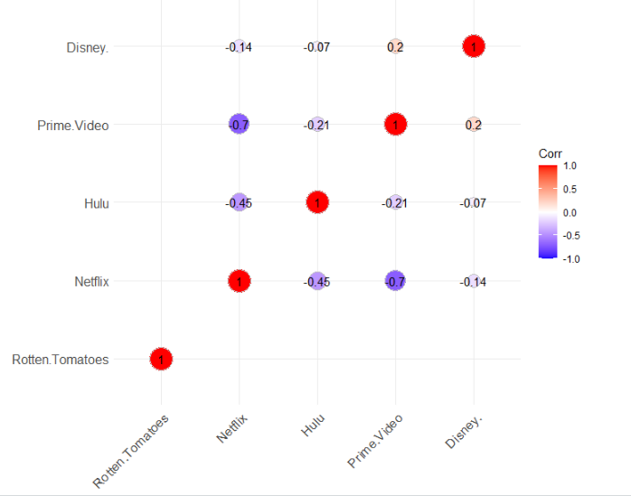
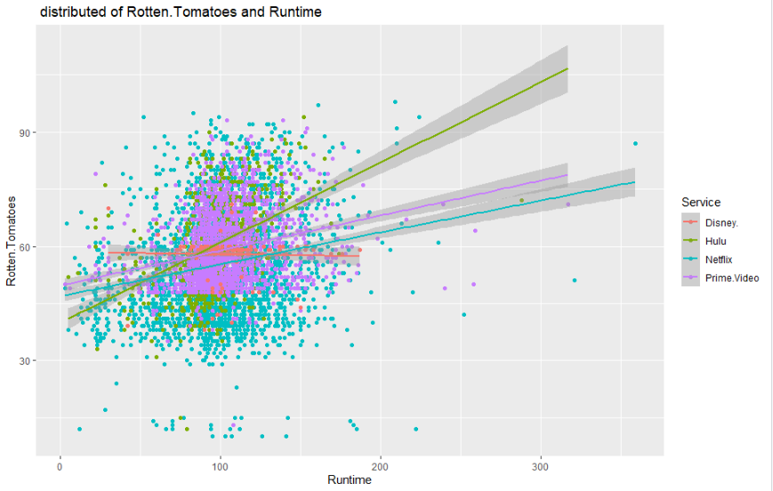
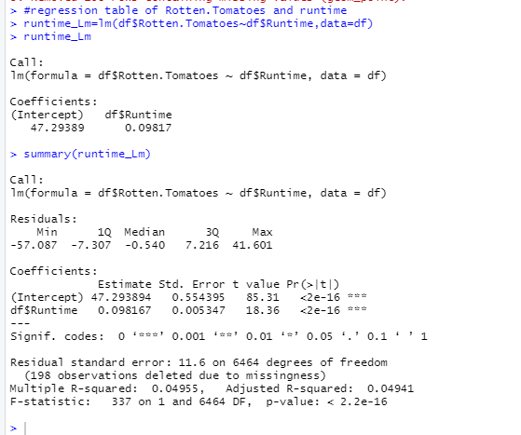
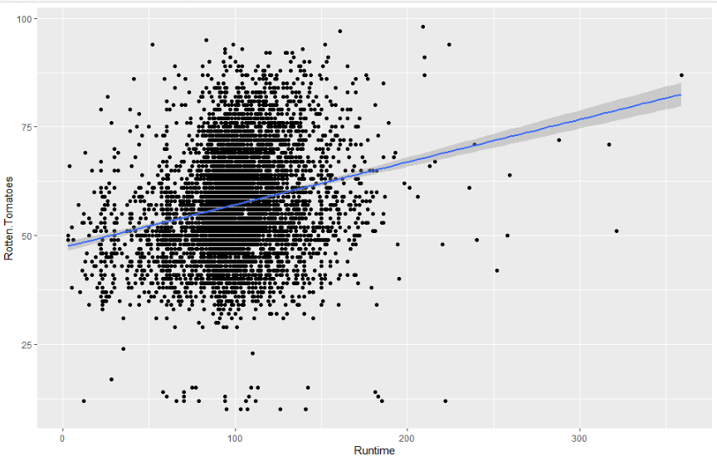
Question 3
Is there a correlation between Runtime and Rotten Tomatoes scores?
Prime Video and NETFLIX :
negative correlation
Disney and Prime Video:
positive correlation
Weak variation: 4.94%
The equation is considered accurate
positive correlation
Question
More viewers may find the movie good, so they are willing to watch it more times, and thus the higher the score.
Runtime & Rotten. Tomatoes
P- value is less than 2.2e-16 (<0.05)
Multiple R-squared is 0.04955
Adjusted R-squared is 0.04941
Each platform of Runtime &
Rotten. Tomatoes

Slide 8
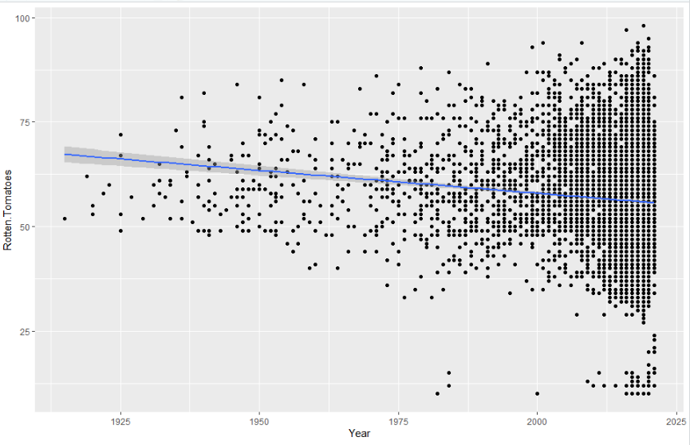
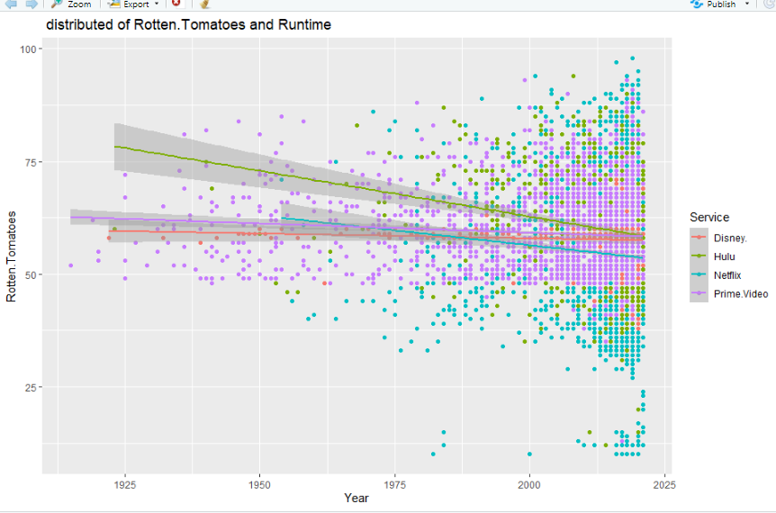
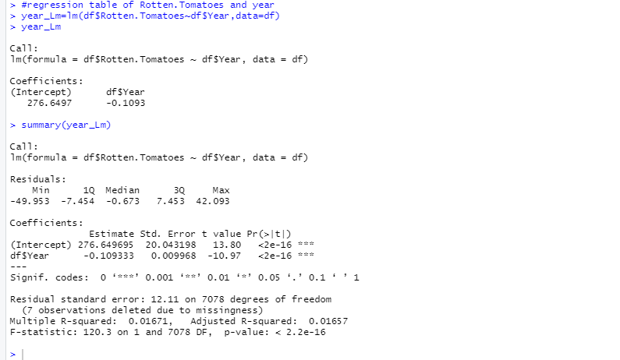
Question 4
Is there a correlation between Year and Rotten Tomatoes scores?
Year & Rotten. Tomatoes
Question
Each platform of Runtime & Year
P- value is less than 2.2e-16 (<0.05)
Multiple R-squared is 0.01671
Adjusted R-squared is 0.01657
The rating will decrease year by year along with the increasing number of movies.

Slide 9

Conclusion
Of the four platforms, the preference is to purchase a membership to Netflix.
- Netflix shows a large number of movies of any age
- Netflix movie ratings on Rotten Tomatoes are more consistent
Rotten Tomatoes has an unbiased rating with enough data to back it up
Rotten Tomatoes and runtime: the more runtime a movie has, the higher the rating
Rotten Tomatoes and year: rating will decrease year by year along with the increasing number of movies

Slide 10

THANKS
Yijun Wang

Slide 11

